Slide 1
High-Frequency Trading
and
Limit Order Book Dynamics
Anton Rubisov
Space Robotics Lab
2014 10 23

Slide 2
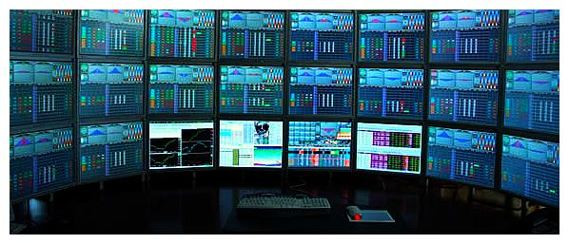
A few definitions to begin...
High Frequency Trading:
    rapid (< 1s) transactions
    algorithmic execution
    maintain no inventory at day's end

Slide 3
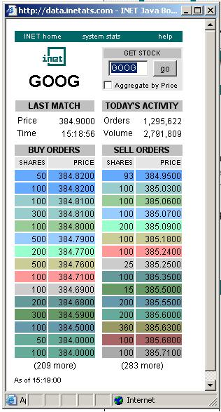
A few definitions to begin...
Limit Order Book (LOB):
    a system (in the dynamics sense)
    tracks arrival of buy and sell orders of a given asset
    executes trades when a match is made

Slide 4
Limit Order Book Mechanics
whiteboard

Slide 5
Research Goal
Our goal is to use the dynamics of the Limit Order Book (LOB) as an indicator for high-frequency stock price movement, thus enabling statistical arbitrage. Formally, we will the study limit order book imbalance process, , and the stock price process, , and attempt to establish a stochastic relationship . We will then attempt to derive an optimal trading strategy based on the observed relationship.

Slide 6
Research Goal
Understand LOB dynamics
Establish relationship between order imbalance and price change
Derive optimal trading strategy

Slide 7
LOB Mechanics
Data provided:
Timestamp | Order ID | Order Code | Volume (Lots) | Price
34200121 | 4582198 | 66 (Buy) | 1000 | 391500
34200121 | 5614888 | 83 (Sell) | 400 | 413900
34200121 | 5614872 | 66 (Buy) | 300 | 390900
34200121 | 5614873 | 66 (Buy) | 300 | 389400
34200122 | 5863776 | 68 (Cancel) | 100 | 339900
34200123 | 5830690 | 68 (Cancel) | 100 | 460100
34200123 | 6706123 | 66 (Buy) | 100 | 370200
34200123 | 6706214 | 83 (Sell) | 100 | 430800

Slide 8
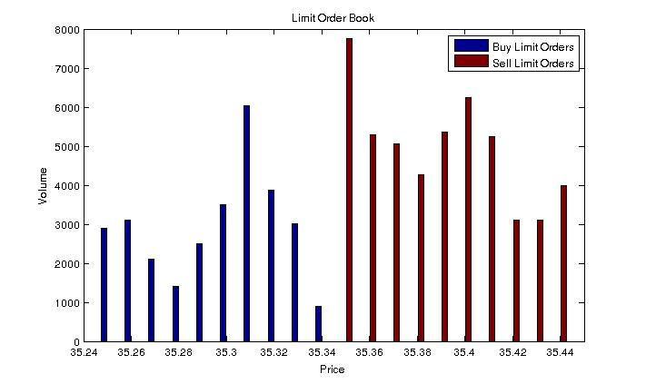
LOB Mechanics
Transformed into:

Slide 9
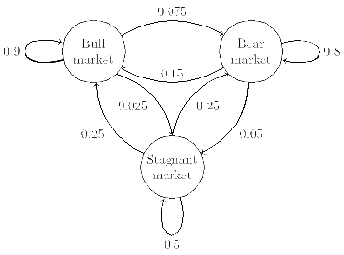
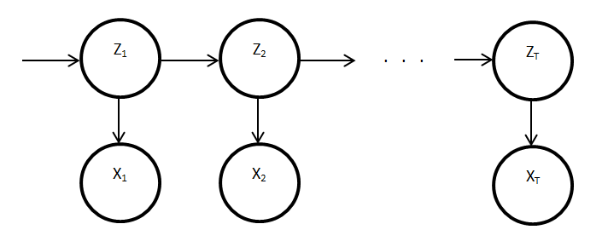
Modeling LOB Imbalance Dynamics
To achieve goal, we need a suitable model
Markov condition considered appropriate
Hence, options:
  Markov Chain, Continuous-Time Markov Chain, Hidden Markov Model, …

Slide 10
Markov Models for Imbalance
Discrete Markov Chain
  Not appropriate for high-frequency trading
HMM:
  Difficult to gauge quality of calibration
Continuous-Time Markov Chain:
  Cross-validation error of at least 50% (non-stationary?)
  Currently considering other calibration/cross-validation methods

Slide 11
Imbalance and Price Change
Consider joint distribution for
Reduced to 1-dimension and estimated CTMC generator matrix , satisfying:
Elements of P are:
Rewritten:

Slide 12
Insights from Joint Distribution
(shorthand)
Using Bayes' Rule, can solve:
Probability of current price change conditional on current imbalance, previous imbalance, and previous price change

Slide 13
Insights from Joint Distribution
Using 3 bins, 1000ms imbalance smoothing, and 500ms price change, we computed:

Slide 14
Insights from Joint Distribution
Using 3 bins, 1000ms imbalance smoothing, and 500ms price change, we computed:
Interpretation: there is price change momentum when staying in same imbalance bin

Slide 15
Next Steps
Tweak everything
Implement naïve trading strategy based on results and backtest to gauge efficacy

Slide 16

Long Term Steps
Derive optimal trading strategy based on Markov Decision Processes
  Bellman equations, dynamic programming
Lots of:

